Slide 1


Operation workflow Management.
Bharati Vidyapeeth College Of Engineering, Navi Mumbai.
Department of Computer Engineering.
Group members:-
Nitin Patil – (48).
Pratik Chakane – (05).
Rahul Gavit – (18).
Guide : Prof. Madhuri Ghuge.
Sponsored by : Synapse
.

Slide 2

TABLE OF CONTENTS
Introduction
Literature Review
Existing Systems
Problem Statement
Proposed Method
Technology used
Methodology
Flow Diagram
Future Scope
Conclusion
References

Slide 3

INTRODUCTION
Operation workﬂow management is concerned with providing automated support for business processes. Typically, a workﬂow involves both people and software applications.
A system that defines, creates, and manages the execution of workflows through the use of software, running on one or more workflow engines, which is able to interpret the process definition, interact with workflow participants, and where required, invoke the use of IT tools and applications.
Workflow Management Coalition, A workﬂow, sometimes used as a synonym for “a business process,” comprises a series of tasks (activities) through which work is routed.
Workﬂow management systems are a class of software that supports business processes by taking on their information logistics, i.e., they ensure that the right information reaches the right person at the right time.

Slide 4
LITERATURE REVIEW
Sr.No | Author | Title | Published at | Observation
1 | Chun Ouyang, Michael Adams, Moe Thandar Wynn, and Arthur H.M. ter Hofstede | Workﬂow Management | Published at : May 2010 ResearchGate International Conference on Business process management | Business process automation considers the internal handling of processes, focusing on the control flow or the tasks of a process.

Slide 5
Sr.No | Author | Title | Published at | Observation
2 | Adams, Michael and ter Hofstede, Arthur H.M. and Edmond, David and van der Aalst, Wil M.P. (2006) Worklets: A Service-Oriented Implementation of Dynamic Flexibility in Workflows. | A Service-Oriented Implementation of Dynamic Flexibility in Workflows | Published at : May 2010 ResearchGate International Conference on Business process management | This paper presents the realization, using a Service Oriented Architecture, of an approach for dynamic flexibility and evolution in workflows through the support of flexible work practices, based not on proprietary frameworks, but on accepted ideas of how people work.

Slide 6
Sr.No | Author | Title | Published at | Observation
3 | Sanjay Jyoti Dutta Department of Computer Application Joydip Sarmah Department of Computer Application Nelson R Varte Department of Computer Application | Human Resource Management | Published at : May 2010 ResearchGate International Conference on Business process management | The Human Management System is a Java based system which provides intranet automation of HR software. The aim of the paper is based on a project that helps the overall management of the employees' tasks , who work in a company.

Slide 7
Sr.No | Author | Title | Published at | Observation
4 | SHI Meilin, YANG Guangxin, XIANG Yong, WU Shangguang. | Workflow Management Systems. | Published at :International Conference on Communication Technology ICCT'98 October 22-24, 1998, Beijing, China | Workflow management systems can help business goals to be achieved with high efficiency by means of sequencing work activities and invoking appropriate human and/or information resources associated with these activities. As computer networks are used more and more widely in daily work, workflow management attracts more and more attention from both industry and research communities.

Slide 8
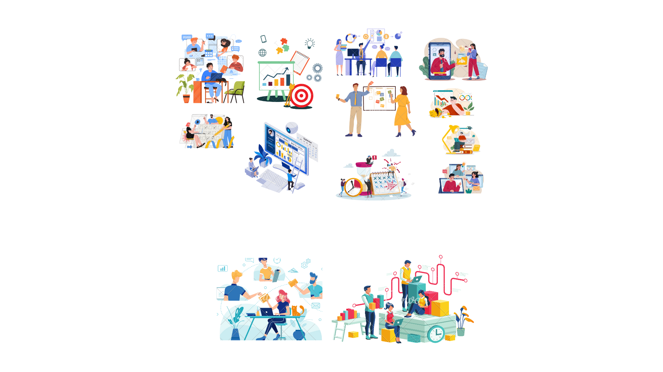
EXISTING SYSTEMS
Dataflow work management user's data or requests can be processed securely and efficiently authorized.
Workﬂow management has its origin in the ofﬁce automation systems of the seventies, but it is not until recently that conceptual and technological breakthroughs have led to its widespread adoption.
In fact, nowadays, process- awareness has become an accepted and integral part of various types of systems

Slide 9

PROBLEM STATEMENT
With the rise in activities(request) and task by participant from urban to rural business, there is increase in the data(request application ) of participants getting generated which is in various forms from text to images and videos. Which had created the problem of assignments of work or task and secure process of the data by the authorized personnel from organizations. The application can be used to solve problems such as delays, duplicated tasks, unnecessary steps, lack of control, and unidentified responsibilities.

Slide 10
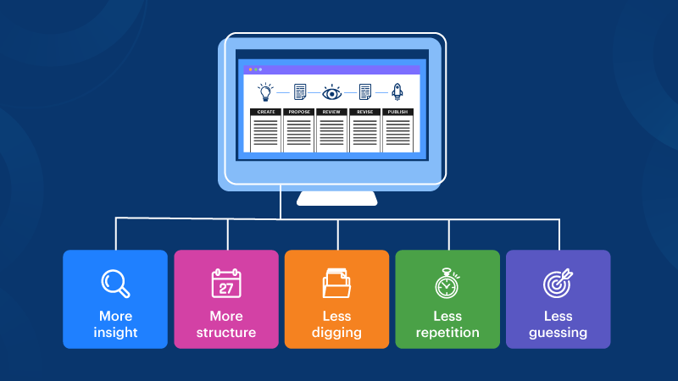
PROPOSED METHOD
Workflow management systems can increase productivity, alleviate employee frustration, and improve customer satisfaction simply by reducing tedious tasks and speeding up response times.
Workflow management also creates visibility into how tasks are completed as well as the roles and steps dedicated to execution.
We build, Automated, optimized and streamlined workflows it's translate into time and money savings.

Slide 11
React.js
Technology Used
React (also known as React.js or ReactJS) is a free and open-source front-end JavaScript library for building user interfaces based on UI components
React can be used as a base in the development of single-page, mobile, or server-rendered applications
ReactJS use JSX
In react the DOM is declarative
React has a huge community because of it’s demand

Slide 12
MySQL
MySQL is an open-source Relational Database Management System that stores data in a structured format using rows and columns.
MYSQL is very flexible .
It’s Platform Independent.
MYSQL is considered one of the fast databases.
MYSQL use multithreading which makes it scalable.

Slide 13
Node.js
Node.js (Node) is an open-source development platform for executing JavaScript code server-side.
Node is useful for developing applications that require a persistent connection from the browser to the server
Is used for real-time applications such as chat, news feeds and web push notifications.
Node.js can generate dynamic page content.
Node.js can create, open, read, write, delete, and close files on the serve

Slide 14
Flask
Flask is a web application framework written in Python.
Flask’s framework is more explicit than Django’s framework
Flask is based on the Werkzeug WSGI toolkit and Jinja2 template engine.
WSGI is a specification for a universal interface
Werkzeug It is a WSGI toolkit.
jinja2 is a popular templating engine for Python.

Slide 15
METHODOLOGY
User will be able to send request to server for registration and ID.
Server send this request to REST API and forwarded to .
User can use premade workflow or can be crated new workflow
Every workflow have different stages and level these level will be select or reject a workflow
After complete All level and stages then it will be available for publicly.
Each individual level is also connected with other stages and all this data is also connected to a document database which is MongoDB where each data stored in database.
This database is also connected to the user and admin account to fulfil any request from Dataflow management.

Slide 16
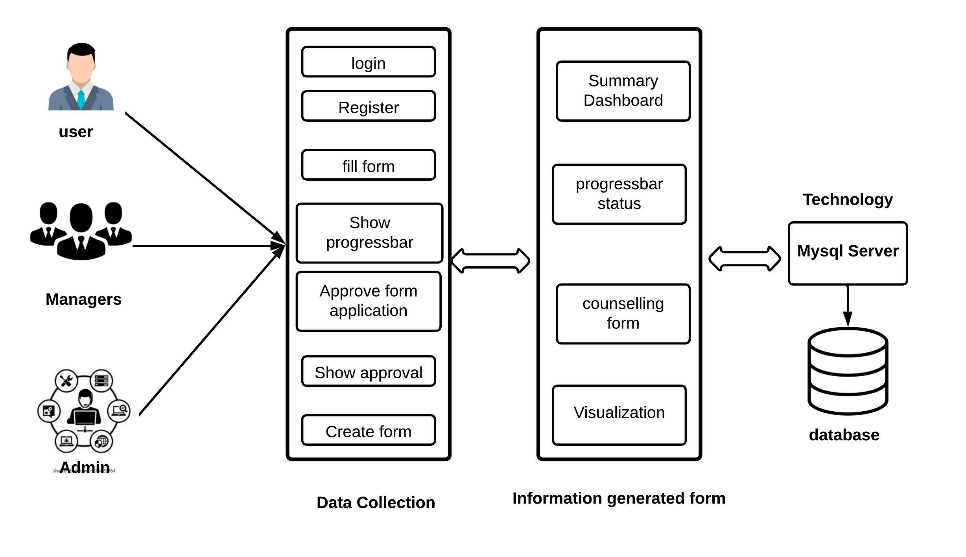
Flow diagram

Slide 17
FUTURE SCOPE
Information achieving :- A system holding all the information and store all data about user.
Integration with payroll system In order for the system to be more comprehensive, an integration of the system to a payroll system that will enable all payment details and gather it one platform

Slide 18
CONCLUSION
Adopting the Operation workflow management solves the significant issues of accessibility and authority.
The use of process-aware information systems, workflows can be specified and enacted, thus providing automated support for business processes.

Slide 19
References
Adams M, Ter Hofstede AHM, Edmond D, van der Aalst WMP (2006) Worklets: a service-oriented implementation of dynamic ﬂexibility in workﬂows. In: Proceedings of the 14th international conference on cooperative information systems. LNCS, vol 4275. Springer, Berlin, pp 291–308
Adams M, Ter Hofstede AHM, van der Aalst WMP, Edmond D (2007) Dynamic, extensible and context-aware exception handling for workﬂows. In: Proceedings of the 15th international conference on cooperative information systems. LNCS, vol 4803, pp 95–112
Decker G, Barros AP (2007) Interaction modelling using BPMN. In: Proceedings of business process management workshops 2007. LNCS, vol 4928. Springer, Heidelberg, pp 208–219
Aldred L, van der Aalst WMP, Dumas M, Ter Hofstede AHM (2007) Communication abstractions for distributed business processes. In: Proceedings of the 19th international conference on advanced information systems engineering. LNCS, vol 4495. Springer, pp 409–423

Slide 20
Giaglis G, Paul R, Doukidis G (1996) Simulation for intra- and inter-organisational business process modeling. In: Proceedings of the 28th conference on winter simulation, pp 1297–1308
Hallerbach A, Bauer T, Reichert M (2010) Conﬁguration and management of process variants. In: vom Brocke J, Rosemann M (eds) Handbook on business process management, vol 1. Springer, Heidelberg
Aldred L, van der Aalst WMP, Dumas M, ter Hofstede AHM (2007) Communication abstractions for distributed business processes. In: Proceedings of the 19th international conference on advanced information systems engineering. LNCS, vol 4495. Springer, pp 409–423

Slide 21
THANK YOU

